Slide 1

IT Infrastructure Management Chapter 5: ITIL MANAGEMENT PRACTICES TY B.Sc. (IT)
Semester VI
Poornima .N
Assistant Professor, Department of IT/CS
1

Slide 2

1 Topics:
General Management Practices:
Service Management Practices:
Technical Management Practices:

Slide 3

2 General management
General management practices have been adopted and adapted for service management from general
business management domains.

Slide 4
2 Service management
Service management practices have been developed in service management and ITSM industries.

Slide 5
2 Technical management
Technical management practices have been adapted from technology management domains for service
management purposes by expanding or shifting their focus from technology solutions to IT services.

Slide 6
1. Architecture management

Slide 7
2 1. Architecture management:
Architecture Management ensures all parts of the organization fit and work together properly (processes, people, technology). 👉 Like a blueprint for services and systems.

Slide 8
2 1. Purpose:
🎯 To help the organization achieve its goals now and in the future, in a structured and Agile way.
✔ Reduce complexity ✔ Manage change easily ✔ Avoid risk and confusion ✔ Improve automation & efficiency

Slide 9
2 1. Why do we need it?
Without architecture management → organization becomes:
⚠️ Confusing systems ⚠️ Different processes everywhere ⚠️ Many outdated technologies ⚠️ High risk when changes happen
So architecture gives visibility + coordination.

Slide 10
2 1. Five Architecture Domains
Type | Simple Student Example
Business | College goals, courses, departments
Service | How admission portal, LMS, ERP connect
Information | Student records, results, attendance data
Technology | Wi-Fi, servers, software, lab systems
Environmental | Rules → NAAC, University norms, legal policies

Slide 11
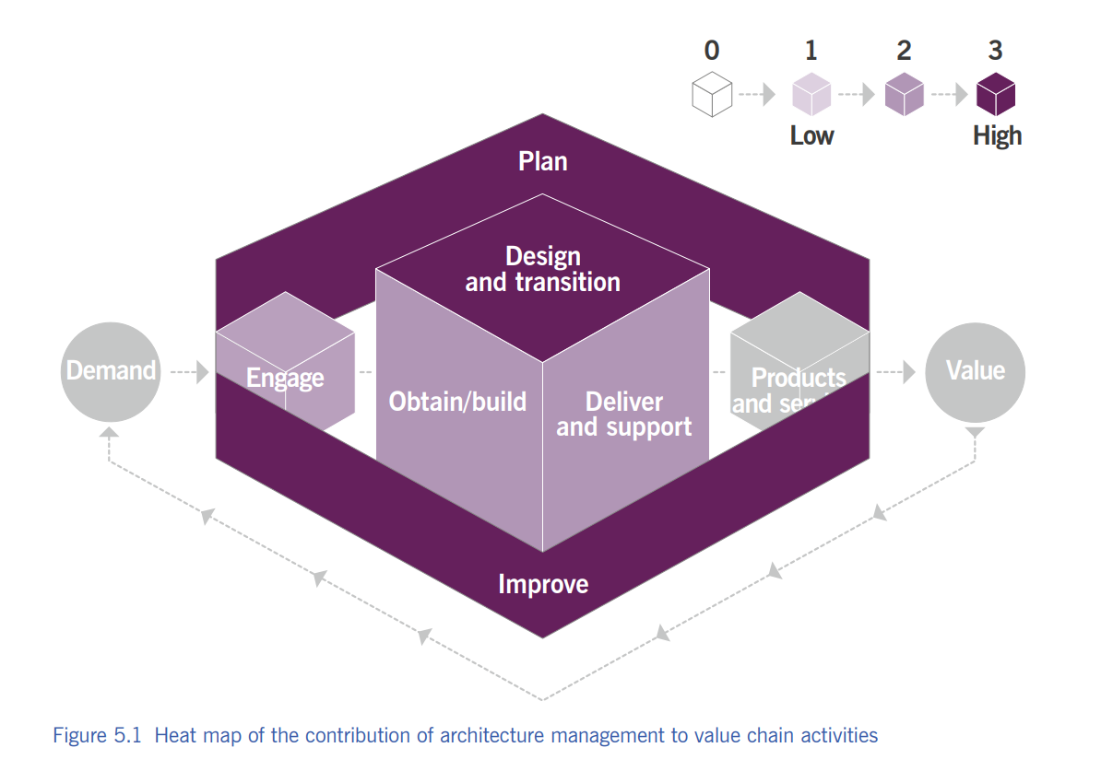

Slide 12
2 1. Real College Example
When college introduces new online exam system:
✔ Business → Who needs what? ✔ Service → How modules fit together? ✔ Information → Secure student data? ✔ Technology → Wi-Fi, servers ready? ✔ Environmental → University rules followed?
That is Architecture Management in action!

Slide 13
2 1. ⏳ Activity: “Build Your Ideal College”
Design a PERFECT college (as architects). What will you plan in each BSITE domain?
✔ Business → Who needs what? ✔ Service → How modules fit together? ✔ Information → Secure student data? ✔ Technology → Wi-Fi, servers ready? ✔ Environmental → University rules followed?

Slide 14
2. Continual Improvement

Slide 15

3 2. Continual Improvement
Continual Improvement means regularly improving services, processes, and products so they remain aligned with changing business needs.

Slide 16
3 2. Why is it Important?
💡 Because:
Customer expectations keep changing
Technology keeps changing
Competitors keep improving
➡️ So we must also keep improving — step by step.

Slide 17
3 2. Real-Life Example
Example: Your College 🎓
Before | After Improvement
Slow admission process | Online form introduced
Students confused about timetable | Timetable on WhatsApp + notice board
Delayed assignments | Google Classroom reminders
👉 This is Continual Improvement in action.

Slide 18
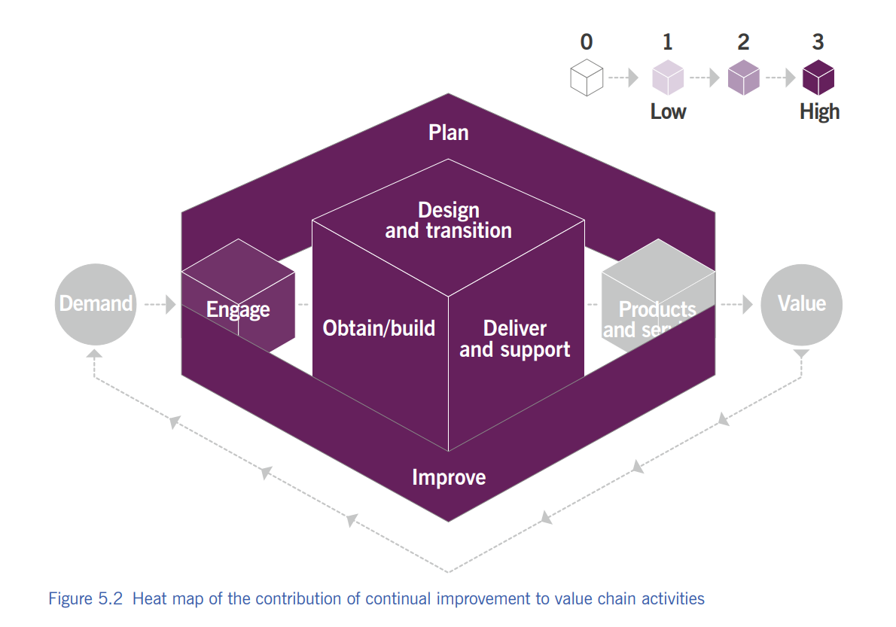

Slide 19
3 2. Where Improvement Ideas Come From
SWOT analysis
Audits or reviews
Customer feedback
Market changes
Problem management / incident data
Staff suggestions
DevOps / Agile feedback cycles

Slide 20
3 2. Who is Responsible?
🔥 EVERYONE. Not only management.
Students can suggest improvements
Teachers improve teaching style
Management improves system
Vendors/suppliers must also improve service
Add line to make it memorable:

Slide 21
3 2. Continual Improvement Register (CIR)
A record where improvement ideas are stored, reviewed, and tracked until completed.
Idea | Priority | Status
Online fees option | High | Completed
More fans in classrooms | Medium | In progress
College app | Low | Planned

Slide 22
3 2. Activity Name: “Fix Your Classroom 🚧”
Look around the classroom or college and find 2 things that can be improved.
They write them on paper or raise hand.
You choose 5 best ideas and convert them into a CIR table on the board.

Slide 23

4 3: Information Security Management (ISM)
It protects the organization's information from unauthorized access, misuse, loss, or damage.

Slide 24

4 3: Why is it Needed?
🤔 If someone steals:
Your exam question papers
Your bank OTP
Your login password
Your Aadhaar number
➡️ BOOM 💥 you're in trouble.
So we protect information just like we protect our money or phones.

Slide 25
4 3: The CIA Triad
⭐ This is the HEART ❤️ of Information Security.
🔑 Element | Meaning | Example
C – Confidentiality | Only authorized people can access info | Password on phone
I – Integrity | Information must remain accurate & unchanged | Marksheet without tampering
A – Availability | Information should be available when needed | Online banking server running

Slide 26
4 3: Extra Security Concepts
✔ Authentication: Proving you are who you claim to be 👉 Example: OTP login
✔ Non-repudiation: You can’t deny your actions later 👉 Example: Digital signature, email trail

Slide 27
4 3: Balance Needed
📌 Information security must balance:
🔹 Security (protect) 🔹 Innovation (work freely)
Quote for the slide:
“Too much security = no work. No security = disaster.”

Slide 28
4 3: Methods Used
Security is implemented using:
🔹 Policies 🔹 Processes 🔹 Behaviours & culture 🔹 Controls (firewalls, passwords, audits) 🔹 Risk management 🔍
🧠 Security isn’t only technology — it's about PEOPLE + PROCESS + TECH.

Slide 29
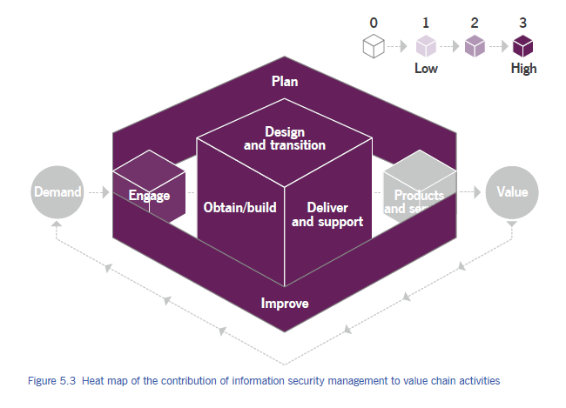

Slide 30
4 3: Who Is Responsible?
👉 Everyone.
But usually managed by:
Chief Information Security Officer (CISO)
Information Security Team
⚠ Biggest weakness in security is NOT technology — it's careless people.
Example line:
Your password shouldn't be: Admin, pooja123, ilovemyself, qwerty……etc

Slide 31
4 3: Activity: “Spot the Risk” Game
Scenario | Secure?
Using same password everywhere
Locking laptop when leaving desk
Sharing OTP with friend
Enabling 2-factor authentication
Clicking unknown link saying "You won 5 crore"

Slide 32
4. Knowledge Management

Slide 33
4 4. What Is Knowledge Management?
Knowledge Management makes sure the right information reaches the right people at the right time so they can work smarter and faster.

Slide 34
4 4. Information vs Knowledge
Information 📄 | Knowledge 🧠
Raw facts | Information + experience + context
Example: 300-page manual | A simple solution guide for service desk
Not always useful | Useful when needed

Slide 35
4 4. Types of Knowledge
Type | Meaning | Example
Explicit | Written, documented | Manuals, FAQs, SOPs
Tacit | In people's minds | Experience, skills, shortcuts

Slide 36
4 4. What KM Ensures
Knowledge Management ensures:
✔ Right information ✔ Correct format ✔ Right time ✔ To the right person ✔ With proper access level
Example: Technician needs a solution fast — NOT a 20-page theory.

Slide 37
4 4. 🎭 Class Activity: “Ask the Expert” Game
Steps:
1️⃣ Pick 3 students. 2️⃣ They act as “Knowledge Desk”. 3️⃣ Others ask them a simple tech or college-related question. 4️⃣ If the student knows → 👍 5️⃣ If not → They must ask another student (KM = sharing knowledge).

Slide 38
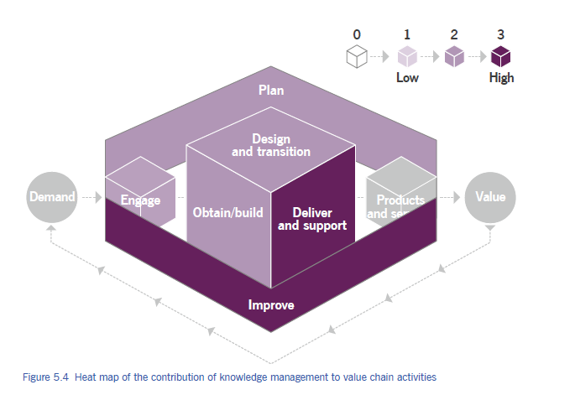

Slide 39
5. Measurement and reporting

Slide 40
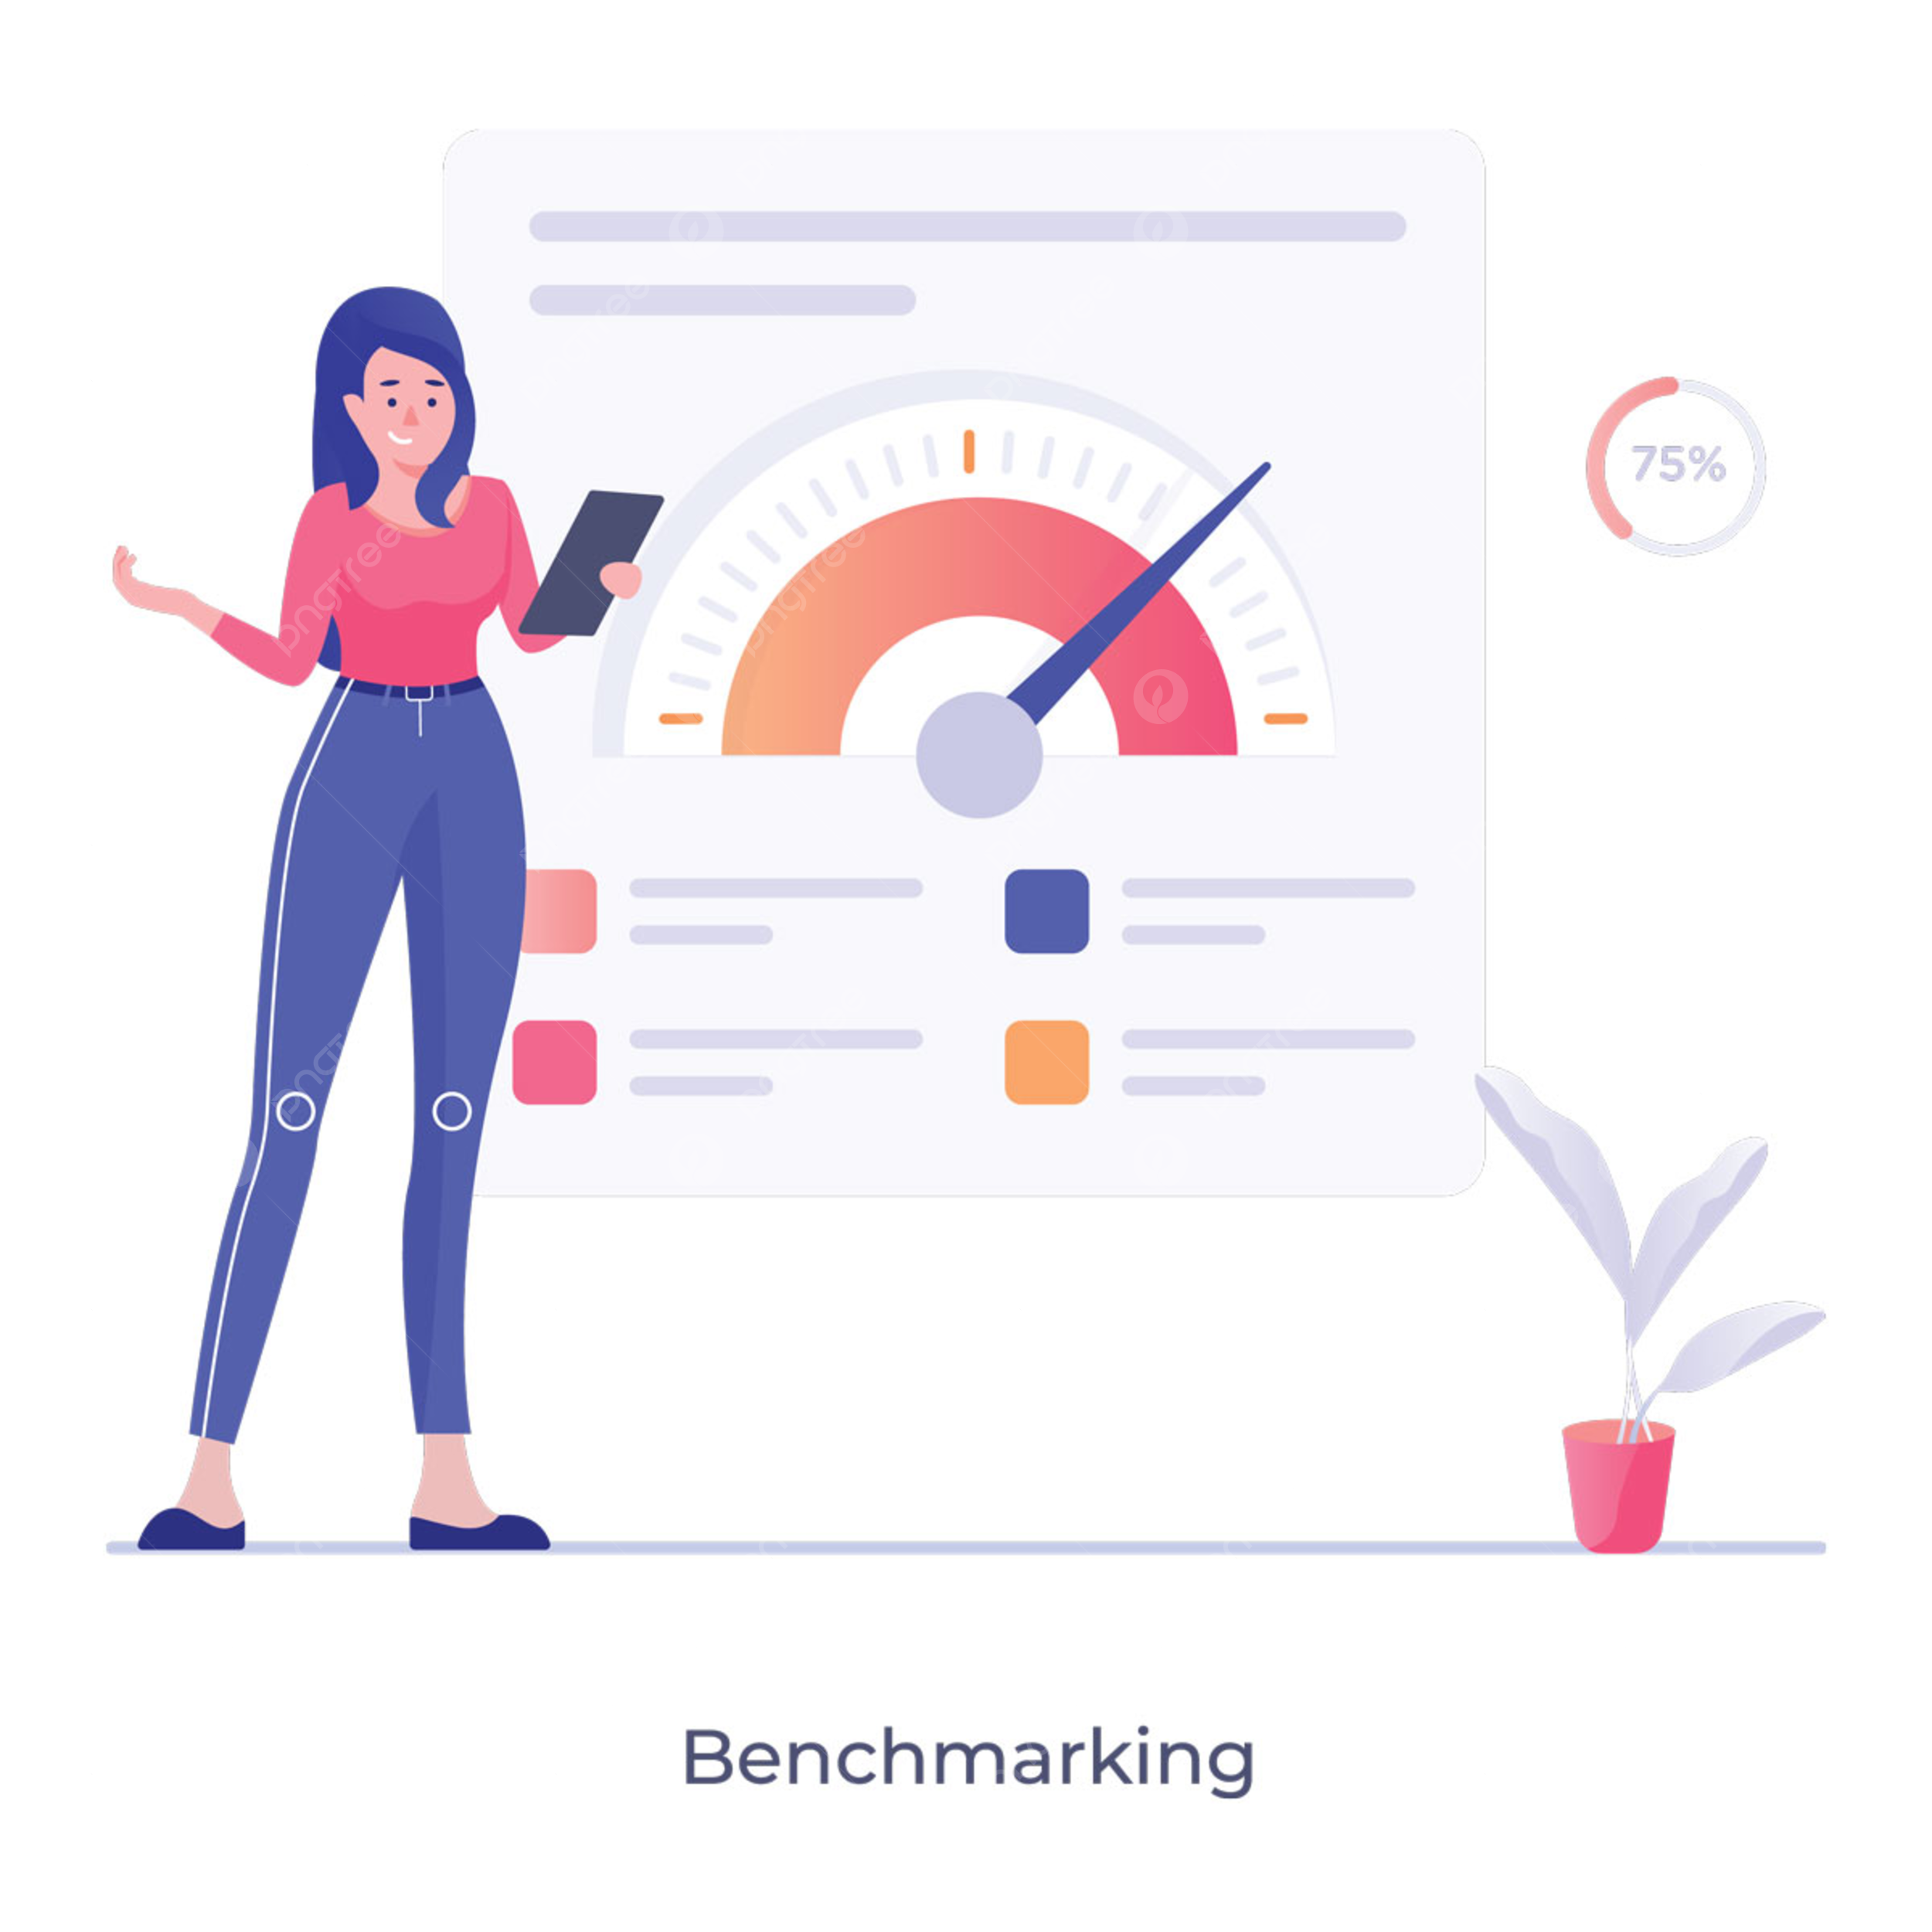
4 5. What is Measurement & Reporting
Measurement & Reporting helps organizations make better decisions by reducing uncertainty through the correct collection and analysis of data.

Slide 41
4 5. What Do We Measure?
Managed objects include:
Products & services
Practices & processes
Value chain activities
Teams & individuals
Suppliers & partners
Entire organization
➡ All these are connected, so their metrics are connected too.

Slide 42
4 5. Why Measurement Matters?
🎯 Organizational goals could be about:
Profit
Growth
Customer satisfaction
Public service
MeasuremCompetitive advantage
ent links big goals → CSFs → KPIs.

Slide 43
4 5. CSF vs KPI
Term | Meaning | Example
CSF (Critical Success Factor) | A must-have condition to succeed | “Resolve 80% incidents on first call”
KPI (Key Performance Indicator) | A metric used to judge success | “First call resolution %”

Slide 44
4 5. Why Measurement Matters?
KPIs can motivate, but they can also spoil behaviour if used wrong.
📌 Example of Wrong KPI:
Service desk staff asked to keep calls short → They may rush calls → poor resolution → unhappy customers
✔ Better approach: Team KPIs, not individual-only KPIs 😊 Encourages collaboration 😊 Less pressure 😊 Aligns with organizational value

Slide 45
4 5. Good Measurement = Good Reporting
Metrics → Reports → Decisions
Reports should answer two questions:
1️⃣ How far are we from the target? 2️⃣ What bottlenecks are stopping us?
🖼️ Idea: dashboard screenshot style

Slide 46
4 5. What a Good Report Looks Like
✔ Clear ✔ Visual ✔ Relevant ✔ Action-oriented ✔ Up-to-date ✔ Easy to understand
Examples:
Traffic light signals (red–yellow–green)
Trend charts
Pie charts
Progress bars

Slide 47
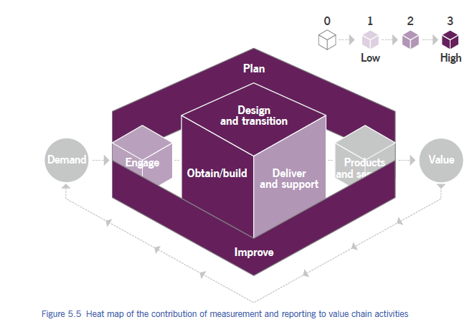

Slide 48
4 5. 🎮 Class Activity “Dashboard Detective”
What metric needs improvement?
What is performing well?

Slide 49
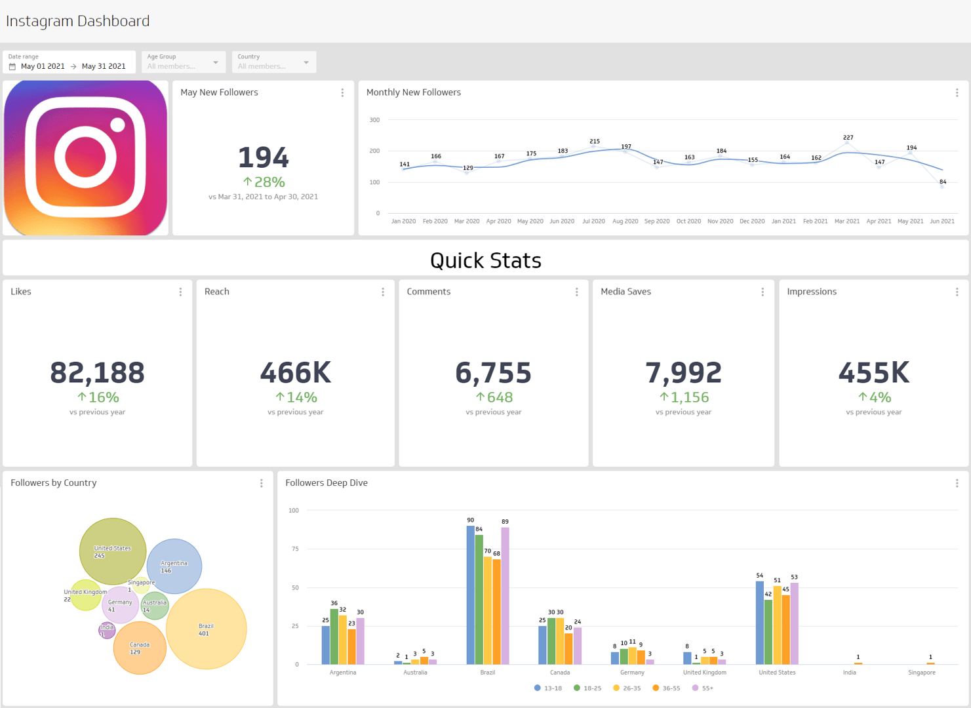

Slide 50
6. Organizational Change Management

Slide 51
4 6. Organizational Change Management
To ensure organizational changes are smoothly implemented and deliver lasting benefits by managing the human aspects.
Activity: 📌 Quick poll: “What makes people resist change the most? Fear? Workload? Confusion?”

Slide 52
4 6. Why Change Management?
Change affects roles, behaviour, work methods
People are the biggest factor in success
Without people’s support → even good changes fail
Mini-game: ❓ True/False: “Technology changes fail mainly due to technical issues.”

Slide 53
4 6. What OCM Achieves
Organizational Change Management helps:
Reduce resistance
Address impacts
Provide training & communication
Ensure successful adoption

Slide 54
4 6. Essential Elements of Successful Change
1️⃣ Clear & relevant objectives 2️⃣ Strong & committed leadership 3️⃣ Willing & prepared participants 4️⃣ Sustained improvement

Slide 55
4 6. A. Clear & Relevant Objectives
People support change when goals make sense
Objectives must provide real value
Must be communicated in context
Activity: ✍️ Micro-task: Write 1 example of a “bad change objective”.

Slide 56
4 6. B. Strong & Committed Leadership
Sponsors advocate and authorize the change
Leaders must be visible and consistent
Communication from leaders builds trust
Activity: 🎯 Identify: “Who is a sponsor? Who is a leader?”

Slide 57
4 6. C. Willing & Prepared Participants
People must believe the change matters
Training + awareness improves readiness
Frequent communication = lower fear
Activity: 🗣️ Role-play: “Trainer convincing a team about upcoming change.”

Slide 58
4 6. D. Sustained Improvement
Avoid “reverting to old habits”
Reinforce with: ✔ Communication ✔ Metrics ✔ Leader support ✔ Addressing impacts
Quick Quiz: “What happens if reinforcement is missing?”

Slide 59
4 6. Key OCM Activities
Activity | Helps Deliver
Sense of urgency | Clear objectives, willing participants
Stakeholder management | Strong participants
Sponsor management | Strong leadership
Communication | Prepared participants
Empowerment | Prepared participants
Resistance management | Willing participants
Reinforcement | Sustained improvement

Slide 60
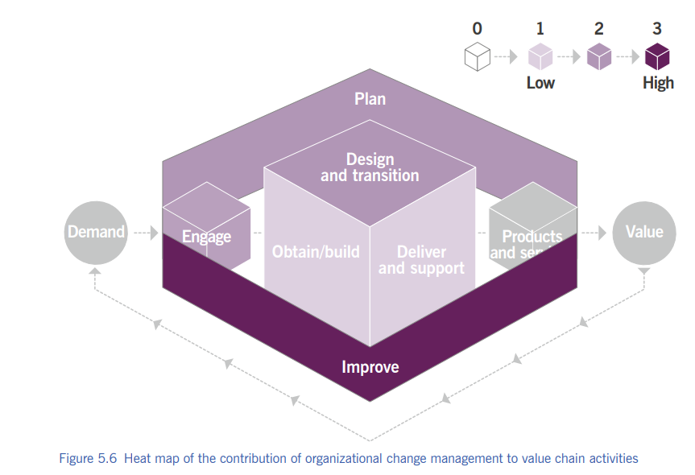

Slide 61
4 6. 🎮 “Change Resistance Bingo”
The school is switching to a new grading system.
We are introducing a new group project format.
The lunch menu is changing (e.g., healthier options only).
The dress code is being updated (e.g., stricter or more relaxed rules).
A new mandatory after-school program is being implemented.
The classroom seating arrangement will be flexible/chosen by students.
Students will be required to use a specific new software program for all assignments.

Slide 62
4 6. 🎮 “Change Resistance Bingo”
Learners mark boxes with common resistance lines like:
"This will never work."
"Why should we change?"
"We always did it this way."
"No one else is doing this."
"It's too complicated/hard."
"That's a stupid idea."
"It's going to be a lot more work."
"They didn't ask for our input."
"The old way was fine."
"I don't have enough time for this."
"This is just a fanny phase; it will pass

Slide 63
4 6. Mini Case Study
“College introduces a new attendance system → students, teachers, admin impacted.” Ask:
Who are stakeholders?
What training is needed?
How to reduce resistance?

Slide 64
7. Portfolio Management

Slide 65
4 7. Portfolio Management
Choosing the right work, at the right time, with the right resources.
Portfolio management = 📂 Deciding WHAT to do ⏳ WHEN to do it 💰 With HOW MUCH money & people
Real-life example: College deciding:
New course ❓
New lab ❓
Website upgrade ❓ (Not all at once!)
Icebreaker: 💬 Ask: “Can an organization do EVERYTHING at once?”

Slide 66
4 7. Portfolio vs Project
Portfolio | Project
Big picture | One task
Strategic | Operational
Long-term | Short-term

Slide 67
4 7. Portfolio vs Project (Mini Game)
Building a single mobile app to track fitness goals. →
Managing all software products for a company like Google. →
Creating a website for a local bakery. →
Overseeing a company’s entire investment in various energy sources (solar, wind, oil). → Writing a single report on market trends for the next quarter. →
Managing a country's total defense initiatives. →
Organizing an annual school carnival. →
Developing a multi-year plan for a city's public transportation system. →
Painting a single room in a house. →
Managing a real estate firm’s entire list of properties and developments. →

Slide 68
4 7. Why Portfolio Management is Needed
Without portfolio management:
Too many changes
Resource conflicts
Low-value projects survive
Strategy fails
Quick Question: ❓ “Is doing more work always good?”

Slide 69
4 7. What Portfolio Management DOES
Portfolio management:
Balances change vs business-as-usual
Aligns work with strategy
Controls investment & risk
Activity: ⚖️ Ask them to balance: “New system vs maintaining old one”

Slide 70
4 7. Activity 1: Evaluation & Prioritization
📋 Mini-Case
3 Projects, budget for only 1
Project | Value | Cost | Strategic Fit
A | High | Medium | Strong
B | Medium | Low | Weak
C | Very High | High | Strong

Slide 71
4 7. Activity 2: Linking to Outcomes
🎮 Game: Match the Following
Item | Correct Match
Service | Long-term strategic benefit
Product | Achieving a business goal
Project | Revenue generation
Programme | Customer satisfaction / Availability

Slide 72
4 7. Activity 3: Portfolio Reviews
❓ Question
“What should be reviewed FIRST?
Options:
Value
Strategic fit
Benefits
Risks
Costs
Progress

Slide 73
4 7. Types of Portfolios (Overview)
Portfolio management includes:
1️⃣ Product/Service Portfolio 2️⃣ Project Portfolio 3️⃣ Customer Portfolio

Slide 74
4 7. Product/Service Portfolio
Includes:
All current services
New services
Improvements
Third-party services
Represents:
Commitments
Investments
Example: College offerings: Degree, Certificate, Online courses

Slide 75
4 7. Project Portfolio
Used to:
Manage authorized projects
Avoid duplication
Control scope, cost, time
Manage programs (multiple projects)
Game: 🧩 Identify: Single project or programme?

Slide 76
4 7. Customer Portfolio
Maintained by:
Relationship management
Records:
All customers
Internal & external
Used to:
Understand customer outcomes
Validate value with customers
Activity: 👥 List internal vs external customers of your college

Slide 77
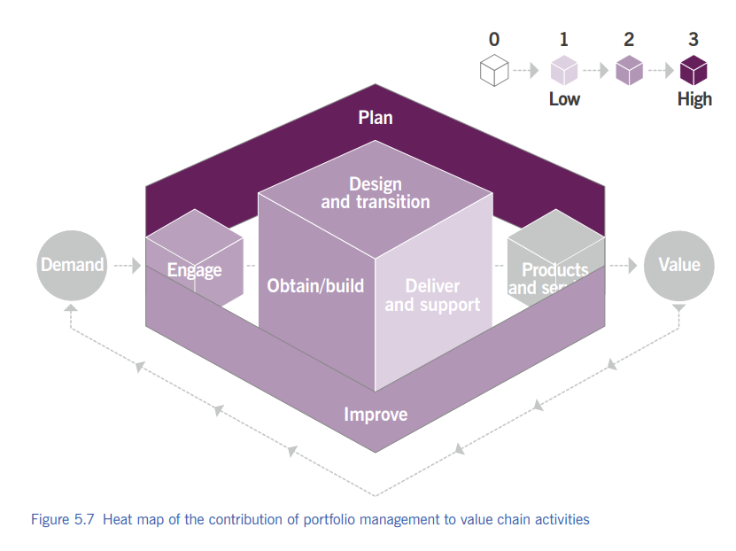

Slide 78
4 7. Exit Activity
🏁 Exit Activity (With Options)
✍️ Complete the sentence by choosing ONE option:
“Portfolio management is important because…”
A️⃣ it aligns work with business strategy B️⃣ it helps use resources efficiently C️⃣ it ensures focus on value delivery D️⃣ it avoids random decision-making E️⃣ All of the above

Slide 79
8. Project Management Turning plans into results

Slide 80
4 8. Project Management
Project management means:
Planning the work
Assigning people
Tracking progress
Fixing problems
Keeping people motivated
Real-life example: 🎉 College fest planning
👉 Project management = making sure the project ACTUALLY finishes

Slide 81
4 8. What is a Project?
A project is:
Temporary
Has a clear goal
Delivers one or more outputs
Based on a business case
Ask students: ❓ “Is daily teaching a project?” (NO – business as usual)

Slide 82
4 8. Why Project Management is Important
Organizations must balance: 1️⃣ Running current operations 2️⃣ Transforming to survive 3️⃣ Continually improving services

Slide 83
4 8. Project vs Business as Usual (Game)
Project | Business as Usual
Temporary | Ongoing
Has end date | No end date
Change-focused | Stability-focused

Slide 84
4 8. Standalone Project or Programme
Projects can be:
Standalone
Part of a programme (many related projects)
Example: 📱 App development programme:
UI project
Backend project
Testing project

Slide 85
4 8. Project & Project Portfolio
Even single projects:
Must align with project portfolio
Must match organizational strategy
Question: ❓ “Should useless projects be allowed?”

Slide 86
4 8. Risk of Poor Project Management
Without proper management:
Resource conflicts
Service disruption
Customer dissatisfaction
Employee burnout
Quick discussion: 😵 “What happens if everyone works on projects AND daily work?”

Slide 87
4 8. Role of People in Projects
Projects depend on:
Right people
Right skills
Right time
Even best plan fails if: ❌ People are missing ❌ No cooperation

Slide 88
4 8. Project Team Reality
Project team members:
Often come from daily operations
Work full-time or part-time
Must balance both roles
Relatable example: 👩‍🏫 Teacher + committee work

Slide 89
4 8. Project Delivery Approaches
Two common methods: 1️⃣ Waterfall 2️⃣ Agile
Waterfall | Agile
Fixed plan | Flexible
Slow changes | Fast changes
Heavy documentation | Working output

Slide 90
4 8. Value Chain: Design & Transition AND Obtain / Build
New service design = project
Major changes = project
Example: 🖥️ New ERP system rollout
Resource acquisition
Development
Integration
All managed as projects
Ask: ❓ “Can development happen without planning?”

Slide 91
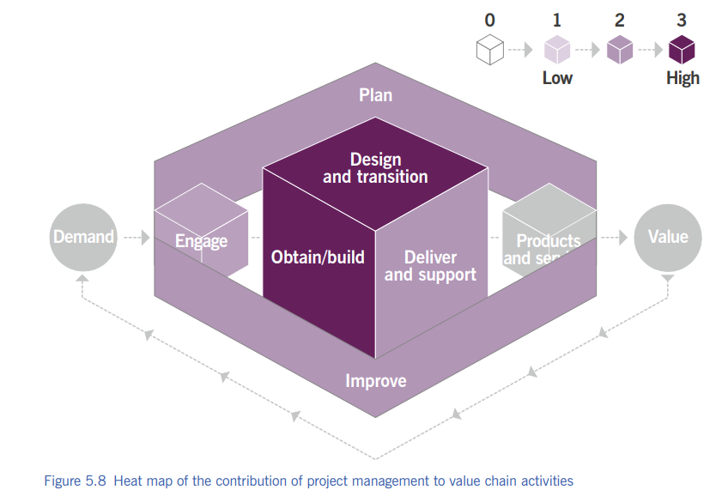

Slide 92
4 8. Summary Slide
✅ Ensures projects succeed ✅ Manages change safely ✅ Balances projects & operations ✅ Supports all value chain activities ✅ People are the key factor

Slide 93
9. Relationship Management Because services are built on relationships

Slide 94
4 9. Relationship Management
Relationship management means:
Understanding people’s needs
Talking to them regularly
Solving conflicts
Keeping everyone satisfied
👉 Good services come from good relationships

Slide 95
4 9. Who Are Stakeholders?
Stakeholders include:
Customers
Users
Sponsors
Employees
Suppliers
Partners
🎮 Activity: Ask students: ❓ “Who are the stakeholders in our college?”

Slide 96
4 9. What Relationship Management Does
This practice ensures that:
✔ Stakeholder needs are understood ✔ Right products/services are prioritized ✔ Customer satisfaction stays high ✔ Trust is built and maintained

Slide 97
4 9. Customer Priorities
Relationship management helps:
Identify customer priorities
Align them with business outcomes
Clearly communicate requirements
Example: 🎓 Students want faster exam results → IT system upgrade

Slide 98
4 9. Handling Complaints & Escalations
Ensures complaints are:
Handled sympathetically
Follow a formal process
Resolved professionally
Key exam phrase: 👉 “Sympathetic yet formal process”

Slide 99
4 9. Value Creation Through Relationships
Relationship management ensures:
Services create value for customers
Services also benefit the organization
Win–win outcomes
🧠 Think: ❓ Can value be created if relationships are bad?

Slide 100
4 9. Managing Conflicting Needs
Example:
Students want flexible deadlines
Management wants strict rules
Relationship management: ✔ Mediates conflicts ✔ Finds balance

Slide 101
4 9. Not Only Customers!
Organizations must manage:
Internal stakeholders
External stakeholders
Not just service consumers!
Key reminder: 👉 Ignoring internal stakeholders = service failure

Slide 102
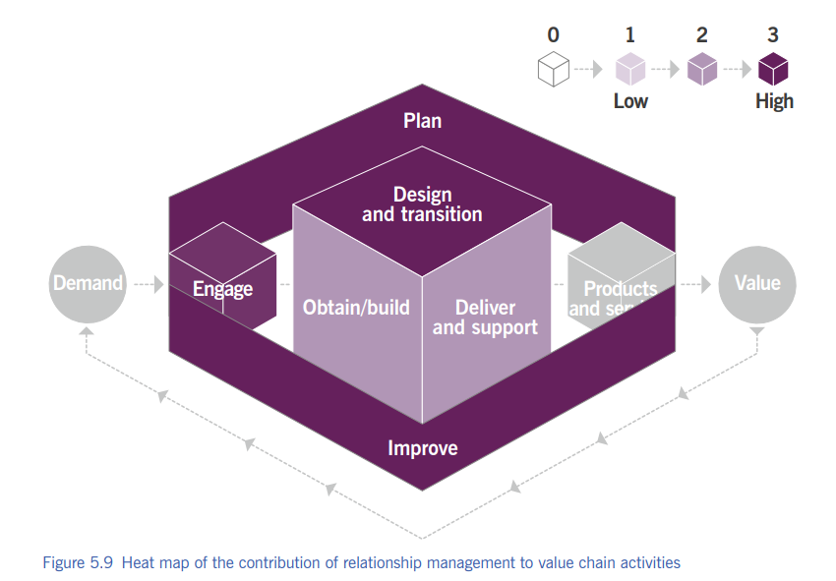

Slide 103
4 9. Summary Slide
✅ Builds trust ✅ Manages stakeholders ✅ Handles conflicts ✅ Improves satisfaction ✅ Supports value creation

Slide 104
10. Risk Management “Is taking no risk also a risk?”

Slide 105
4 10. Risk Management
Risk management means:
Knowing what can go wrong
Knowing what can go right
Deciding what risk is worth taking
👉 Risk includes both threats and opportunities

Slide 106
4 10. Risk Is NOT Always Bad
⚠️ Threat risk:
System failure
Data loss
🌱 Opportunity risk:
Launching a new app
Entering a new market
❌ Avoiding opportunity = also a risk!

Slide 107
4 10. Portfolio & Risk
Every:
Product , Service and Project
Has associated risks.
✔ Good service management → opportunity ❌ Poor service management → threat
Example: New service = value opportunity + failure risk

Slide 108
4 10. Three Core Risk Activities
Are the benefits worth the risk?
Risk management requires:
1️⃣ Identify 2️⃣ Assess 3️⃣ Treat

Slide 109
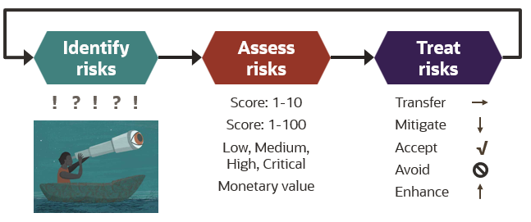

Slide 110
4 10. Risk Identification
✔ Identify uncertainties ✔ Describe them clearly ✔ Ensure common understanding
Example:
“Server may crash during peak usage”

Slide 111
4 10. Risk Assessment
Assess:
Probability (How likely?)
Impact (How serious?)
Proximity (How soon?)
🎯 Result: Risk exposure

Slide 112
4 10. Risk Treatment
Decide what to do:
Avoid
Reduce
Share
Accept
Assign: ✔ Owners ✔ Actions ✔ Monitoring

Slide 113
4 10. Principle: Risk Is Part of Business
✔ Risk cannot be eliminated ✔ Risk-taking is necessary ✔ Must align with risk appetite
🧠 Risk appetite = how much risk an organization is willing to take

Slide 115
4 10. Good Risk Behaviour Includes
Risk management depends on people behavior.
✔ Reporting incidents ✔ Reporting opportunities ✔ Clear roles & responsibilities ✔ Fair reward systems

Slide 116
4 10. ISO 31000 Connection
ISO 31000 says:
“Risk management creates and protects value”
Benefits:
Improves performance
Encourages innovation
Supports objectives

Slide 117
4 10. Classroom Activity: “Risk Spotter” ⚠️
Give scenario:
College online exam system
Ask students to list:
2 threats
1 opportunity
1 risk treatment

Slide 118
4 10. Exam Memory Box
🧠 Remember:
Threat + Opportunity
Identify–Assess–Treat
Risk appetite
Risk culture
ISO 31000

Slide 119
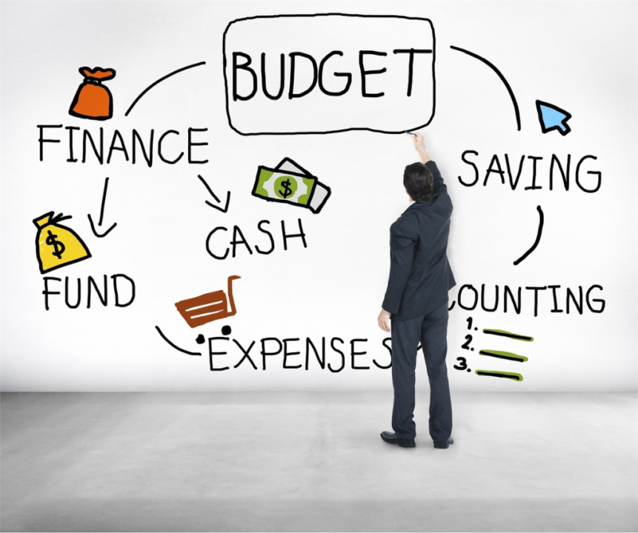
11. Service Financial Management 💰 Managing money for services

Slide 120
4 11. Service financial management
Service financial management answers:
Where should we spend money?
How much does a service cost?
Are we getting value for money?
💡 Right service + right cost + right value
Supports organization’s strategies and plans

Slide 121
4 11. Finance = Common Language
Finance allows communication with:
Management
Customers
Suppliers
Investors
💬 Everyone understands money

Slide 122
4 11. Budgeting & Costing
Predicting and controlling income & expenditure
Includes:
Setting budgets
Monitoring spending
Forecasting service demand
🎓 College example: Department budget planning for labs

Slide 123
4 11. Service-Based Budgeting
Full cost of providing a service
Full cost of consuming a service
🧠 Not just “IT cost” → “Cost per service”

Slide 124
4 11. Accounting
Track how money is actually spent
Includes:
Forecast vs actual comparison
Cost per:
Customer
Service
Activity
Uses: ✔ Ledgers ✔ Journals ✔ Charts of accounts

Slide 125
4 11. Charging
Billing customers for services used
✔ Mostly for external customers ✔ Charging is optional ❌ Funding is NOT optional
🧠 All services must be funded somehow

Slide 126
4 11. Classroom Activity: “Who Pays?” 💸
Give examples:
College Wi-Fi
Netflix
Cloud storage
Ask: ✔ Who pays? ✔ Fixed or usage-based?

Slide 127
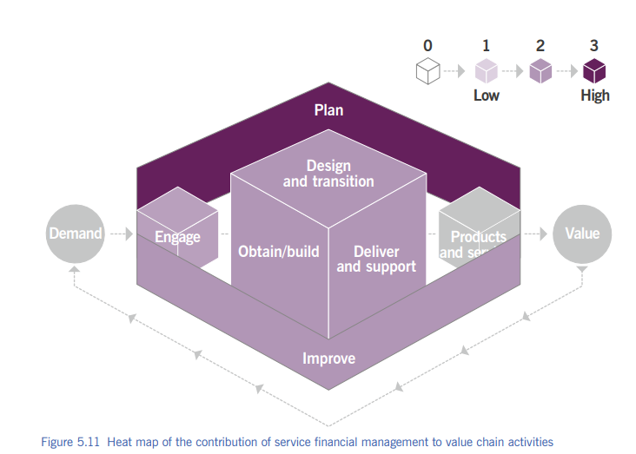

Slide 128
4 11. Value Chain: Plan
Supports planning with:
Budgets
Forecasts
Financial reports
📌 No plan works without money

Slide 129
4 11. IT Budgets: Old vs New
Traditional IT:
CAPEX (one-time purchase)
Fixed budgets
Modern IT (Cloud):
OPEX (subscription)
Pay-as-you-use
🧠 Example: Buying server vs AWS subscription

Slide 130
4 11. CAPEX vs OPEX
CAPEX | OPEX
One-time | Ongoing
Fixed | Variable
Hardware | Subscription

Slide 131
4 11. Procurement Challenges
Cloud services:
Variable pricing
Usage-based payment
Organizations must: ✔ Update procurement rules ✔ Train staff
Otherwise → barrier to digital services

Slide 132
4 11. Exam Memory Box 🧠
Remember: ✔ Budgeting, Accounting, Charging ✔ CAPEX vs OPEX ✔ ROI ✔ Funding vs Charging ✔ Finance supports SVS

Slide 133
4 Strategy Management (What & Why)
Strategy management decides:
Where the organization wants to go
How it will get there
How resources will be used
👉 It sets direction, priorities, and focus
🧠 Strategy = long-term direction of the organization

Slide 134
4 What Strategy Management Does
Strategy management helps the organization to:
Understand environment & opportunities
Identify constraints & risks
Define vision, mission & goals

Slide 135
4 Modern Strategy
Strategy should:
Encourage creativity
Still stay aligned with organizational goals
Balance:
Daily operations
Innovation & future growth
Earlier: rigid long-term planning
Now: flexible + agile + lean strategy

Slide 136
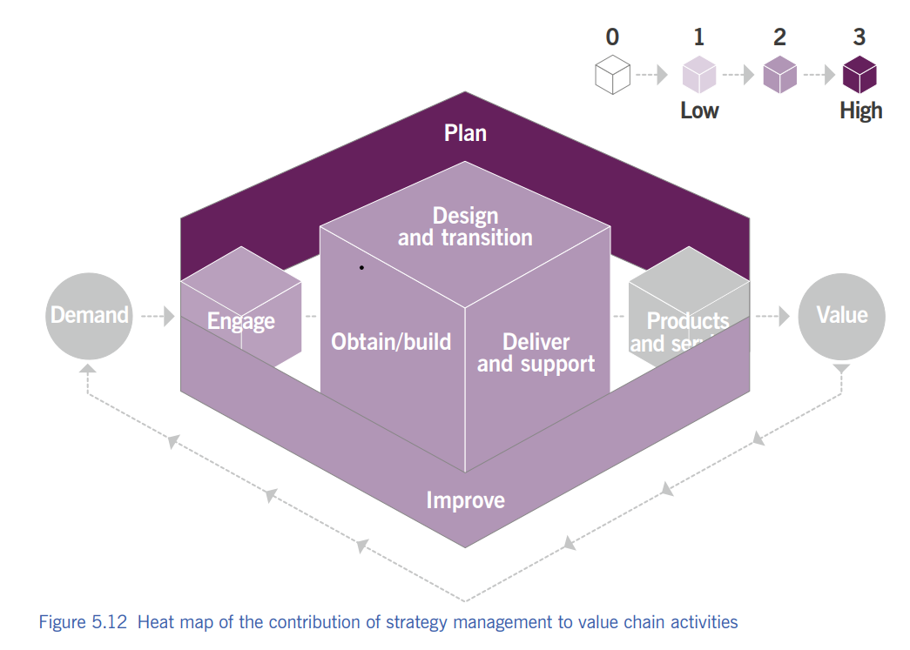

Slide 137
4 SUPPLIER MANAGEMENT
Supplier management ensures suppliers deliver quality products and services as per agreement.
Manage suppliers & contracts
Improve value
Reduce risk

Slide 138
4 Core Activities
Maintain supplier strategy
Negotiate contracts
Manage relationships
Monitor supplier performance
Renew / terminate contracts

Slide 139
4 Supplier Types
Insourcing – work done internally
Outsourcing – work given to external supplier
Single sourcing – one supplier
Multi-sourcing – multiple suppliers

Slide 140
4 Supplier Evaluation Criteria
I-R-C
Importance
Risk
Cost

Slide 141
4 Service Integration
Service integration coordinates multiple suppliers to deliver end-to-end service.
Can be internal
Or external integrator
Or hybrid

Slide 142
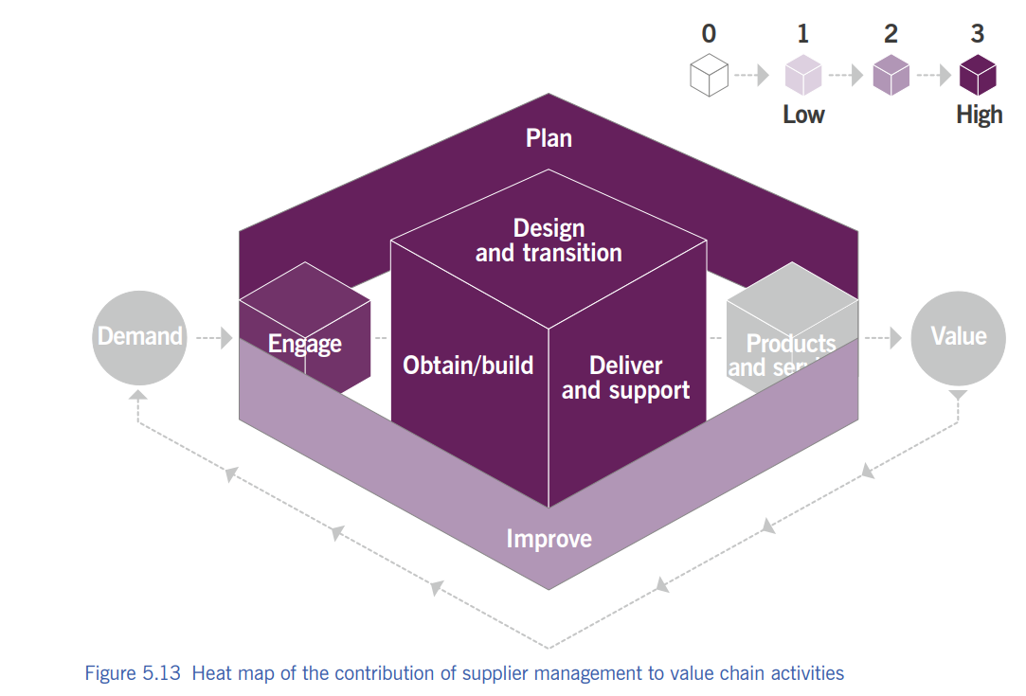

Slide 143
4 Workforce and talent management
Ensures right people, right skills, right role, right time.
Support business goals
Improve organizational velocity
Reduce skill gaps

Slide 144
4 Important Definitions
Organizational velocity → speed & efficiency of organization
Competencies → knowledge + skills + ability + attitude

Slide 145
4 Activities
Workforce planning
Recruitment
Learning & development
Performance measurement
Personal development
Mentoring & succession planning

Slide 146
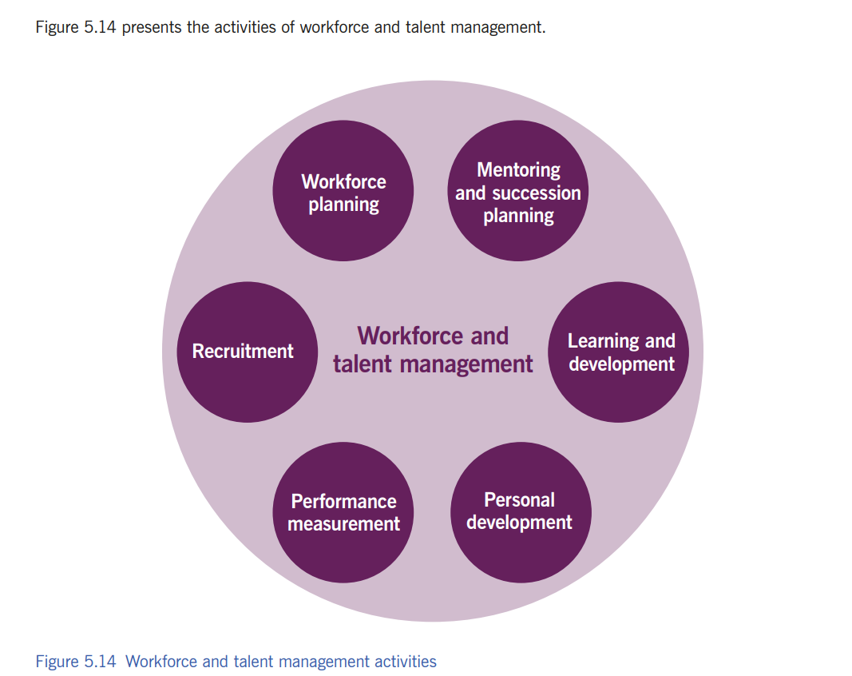

Slide 147
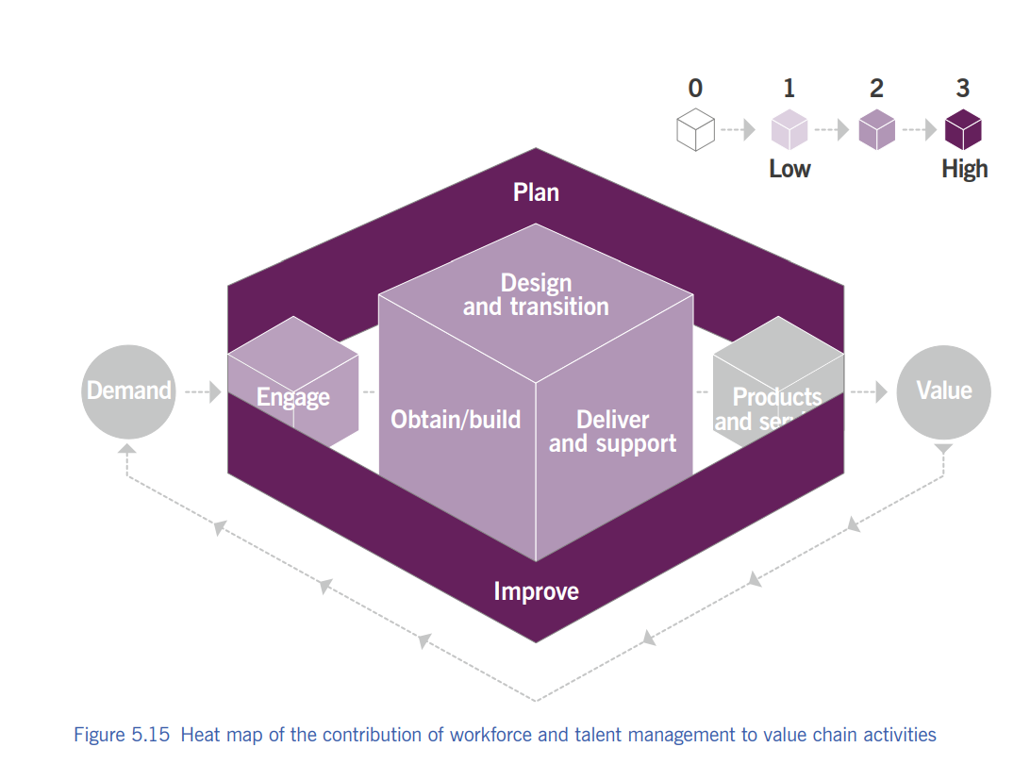

Slide 148
Services Management Practices

Slide 149
2.1 Availability Management

Slide 150
4 Availability Management
To ensure that services deliver agreed levels of availability to meet customer and user needs.

Slide 151
4 What is Availability?
Ability of a service to perform its agreed function when required.

Slide 152
4 Key Activities
Agree availability targets
Design systems to meet availability
Monitor and measure availability
Analyse failures
Plan improvements

Slide 153
4 MTBF & MTRS
MTBF (Mean Time Between Failures) and MTTR (Mean Time To Repair)
MTBF – How often service fails
MTRS – How fast service is restored
Availability = Fail less OR recover faster

Slide 154
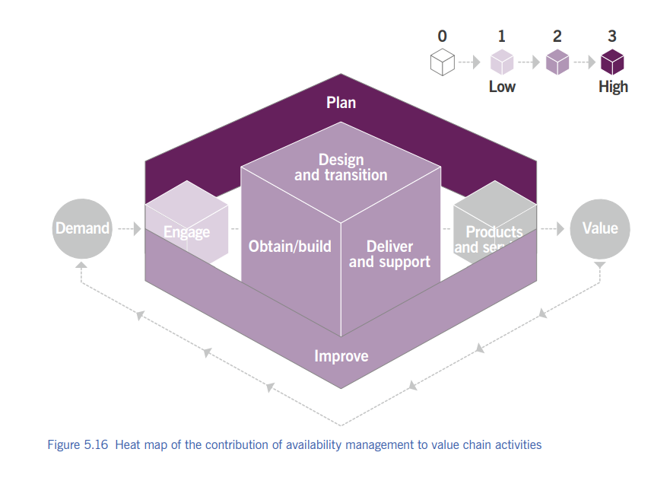

Slide 155
2.2 Business Analysis

Slide 156
4 Business Analysis
To analyse business needs and recommend solutions that create value for stakeholders.

Slide 157
4 What is Business Analysis?
Business Analysis focuses on:
Understanding business problems
Identifying needs and opportunities
Recommending solutions

Slide 158
4 Key Activities
Analyse current business situation
Identify requirements
Evaluate possible solutions
Support decision-making
Ensure solutions deliver value

Slide 159
4 Quick
Wrong requirement = wrong solution = wasted money
Business Analysis = Understand → Analyse → Recommend → Create Value

Slide 160
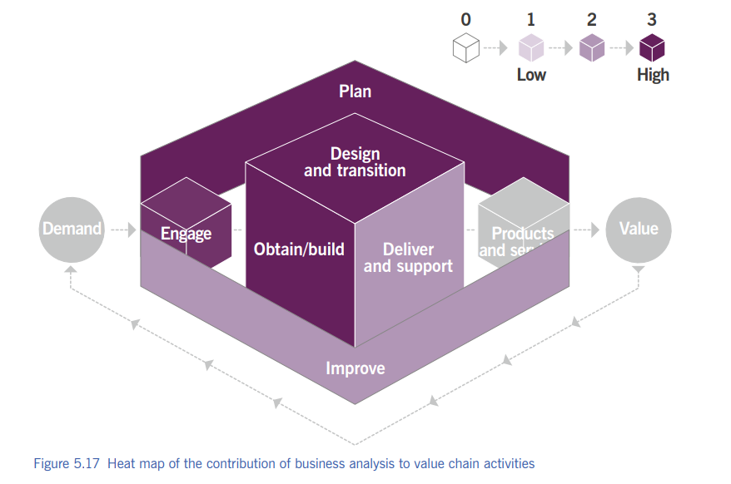

Slide 161
2.3 Capacity and Performance Management

Slide 162
4 Capacity and Performance Management
To ensure that services achieve agreed and expected performance, satisfying current and future demand in a cost-effective way.

Slide 163
4 What is Capacity vs Performance?
Capacity → How much workload a service can handle
Performance → How fast the service responds

Slide 164
4 Key Activities
Monitor system performance
Analyse current and future demand
Plan capacity upgrades
Ensure optimal use of resources
Prevent performance degradation

Slide 165
4 Why it is Important?
Avoids slow systems
Prevents service outages
Supports business growth
Reduces unnecessary costs

Slide 166
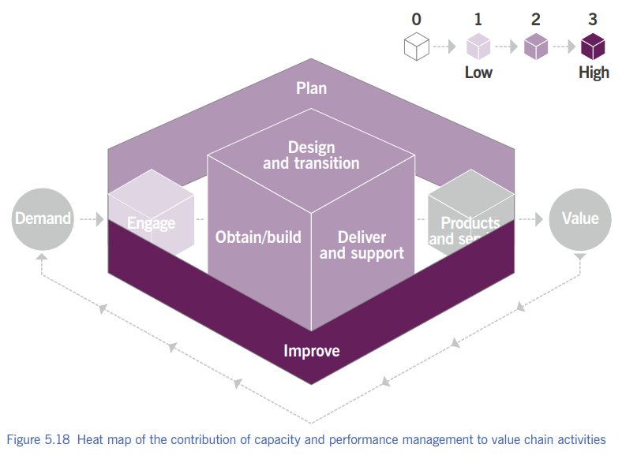

Slide 167
2.4 Change Control

Slide 168
4 Change Control
To ensure that changes to services are carried out in a controlled way to minimize risk and disruption.

Slide 169
4 What is a Change?
Addition, modification, or removal of anything that could affect a service.

Slide 170
4 Types of Changes
Standard change – Low risk, pre-approved
Normal change – Needs assessment & approval
Emergency change – Urgent, high impact

Slide 171
4 Key Activities
Log and assess change requests
Evaluate risks and impact
Authorize changes
Schedule and implement changes
Review changes after implementation

Slide 172
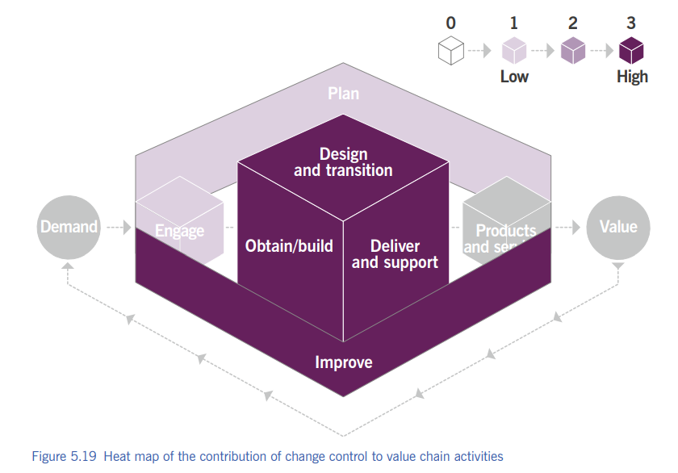

Slide 173
2.5 Incident Management

Slide 174
4 Incident Management
To minimize the negative impact of incidents by restoring normal service operation as quickly as possible.

Slide 175
4 What is an Incident?
An unplanned interruption to a service or reduction in service quality.

Slide 176
4 Incident vs Problem
Incident → Restore service quickly
Problem → Find root cause

Slide 177
4 Key Activities
Detect and log incidents
Categorize and prioritize incidents
Diagnose and resolve incidents
Escalate if required
Close incidents

Slide 178
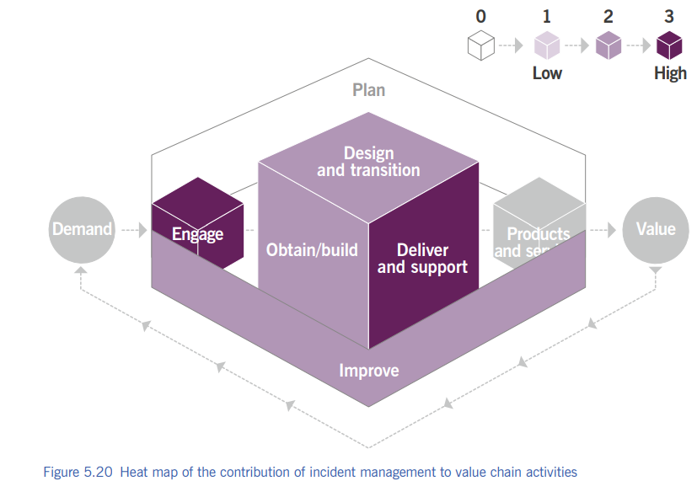

Slide 179
2.6 IT Asset Management

Slide 180
4 IT Asset Management
To plan and manage the full lifecycle of IT assets to help the organization maximize value, control costs, and manage risks.

Slide 181
4 What is an IT Asset?
Any financially valuable component that contributes to IT service delivery.

Slide 182
4 Asset Lifecycle Stages
Plan
Acquire
Use
Maintain
Dispose

Slide 183
4 Key Activities
Maintain asset inventory
Track ownership and location
Manage licenses and compliance
Optimize asset utilization
Control asset costs

Slide 184
4 Why IT Asset Management is Important
Reduces costs
Avoids license penalties
Improves decision-making
Supports risk management

Slide 185
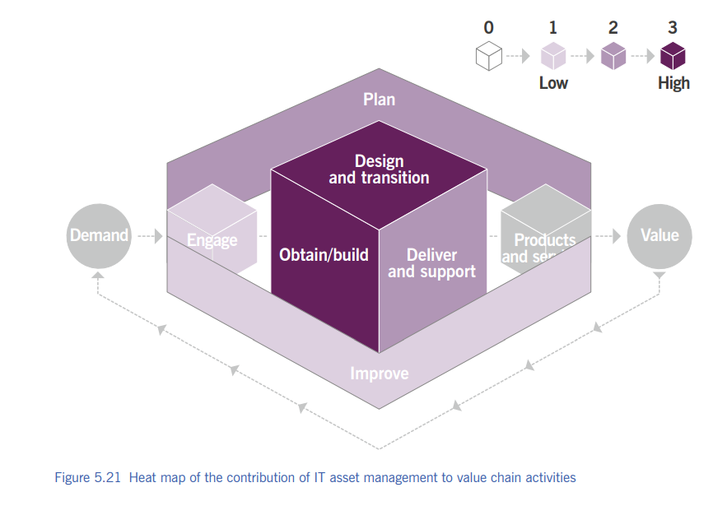

Slide 186
2.7 Monitoring and Event Management

Slide 187
4 Monitoring and Event Management
To systematically observe services and service components and record and report selected changes of state identified as events.

Slide 188
4 What is Monitoring?
Repeated observation of a service or component to detect changes.

Slide 189
4 What is an Event?
Any change of state that has significance for the management of a service.
Types of Events:
Informational – Normal operation
Warning – Threshold approaching
Exception – Service failure

Slide 190
4 Relationship with Incident Management
Events can trigger incidents
Not all events become incidents
Early detection reduces impact

Slide 191
4 Quick
Event = Signal 🚨 Incident = Actual problem 🔥

Slide 192
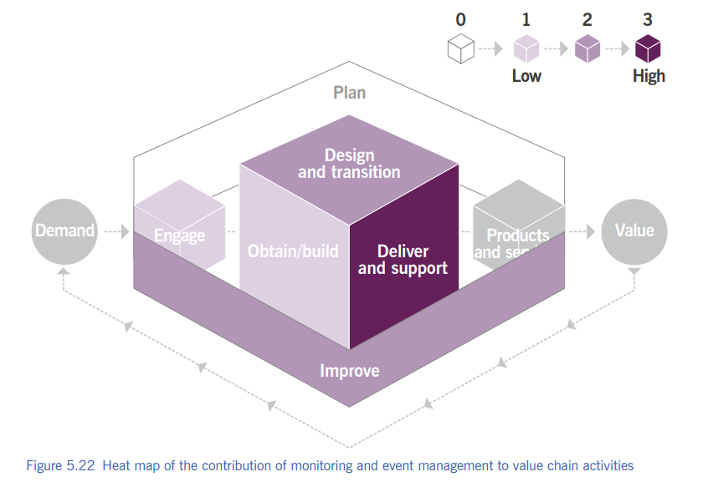

Slide 193
2.8 Problem Management

Slide 194
4 Problem Management
To reduce the likelihood and impact of incidents by identifying and managing the root causes of problems.

Slide 195
4 What is a Problem?
A cause, or potential cause, of one or more incidents.
Example:
Incident: ERP server crashes frequently
Problem: Faulty database configuration

Slide 196
4 Problem vs Incident
Incident → Restore service fast
Problem → Eliminate root cause
“Incidents are symptoms; problems are the disease.”

Slide 197
4 Key Activities
Identify problems
Analyse root cause
Document known errors
Implement permanent solutions
Prevent recurrence

Slide 198
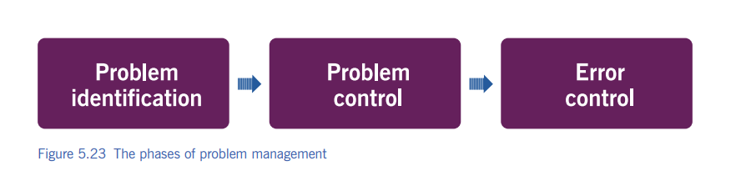
4 Phases of Problem Management

Slide 199
4 Workaround
A temporary solution used to reduce the impact of an incident or problem when the root cause is not yet fixed.

Slide 200
4 Known Error & Error Control
A problem that has been analysed and has a documented root cause and workaround.
Error Control = Managing known errors

Slide 201
Term | Meaning
Problem | Root cause unknown
Known Error | Root cause known
Workaround | Temporary solution
Error Control | Managing known errors

Slide 202
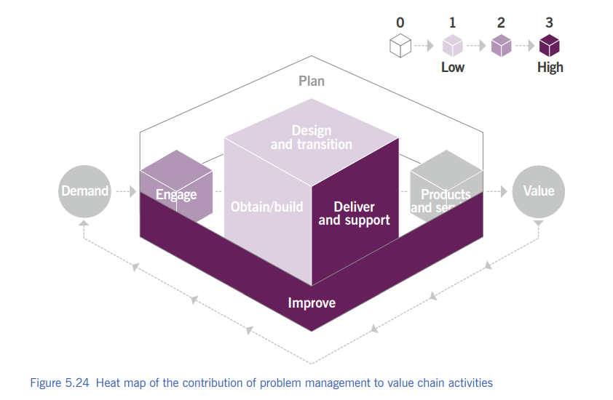

Slide 203
2.9 Release Management

Slide 204
4 Release Management
To make new and changed services and features available for use(deployed successfully).

Slide 205
4 What is a Release?
A version of a service or product that is made available to users.

Slide 206
4 Types of Releases
Major release – Big changes (new version)
Minor release – Small improvements
Emergency release – Urgent fix

Slide 207
4 Key Activities
Plan releases
Build and test release packages
Deploy releases to production
Communicate release details
Review release success

Slide 208
4 Relationship with Other Practices
Change control – Authorizes changes
Service validation & testing – Tests releases
Configuration management – Tracks components
Incident management – Handles release failures

Slide 209
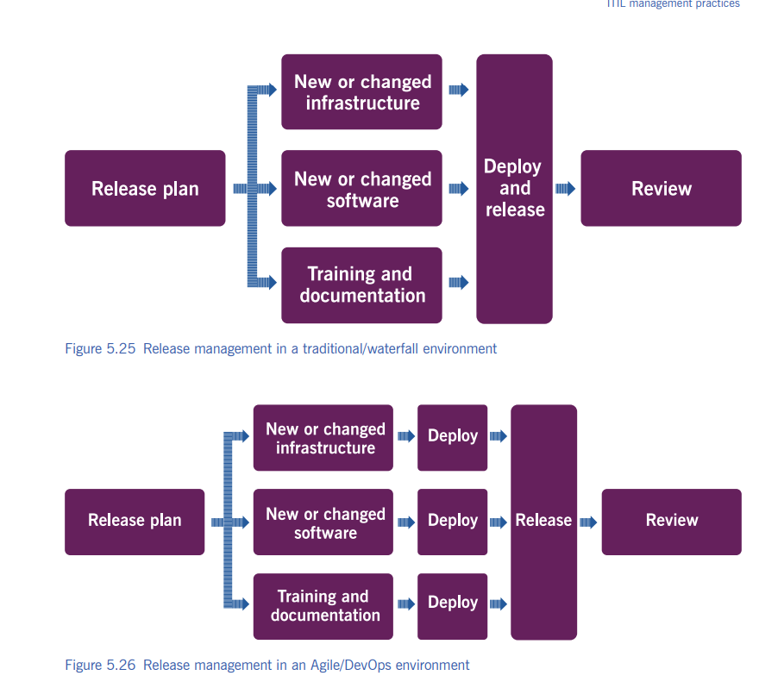

Slide 210
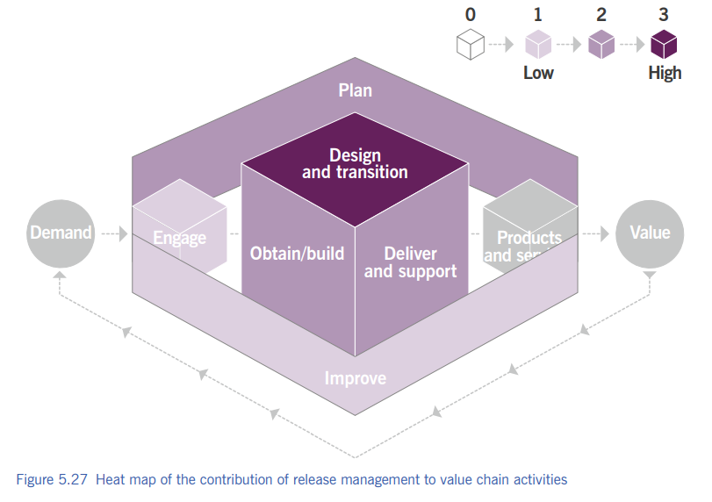

Slide 211
2.10 Service Catalogue Management

Slide 212
4 Service Catalogue Management
To provide a single source of consistent information on all services and service offerings, ensuring it is available to relevant stakeholders.

Slide 213
4 What is a Service Catalogue?
A structured list of all live services offered by the service provider.
“If a service is not in the catalogue, it is not officially offered.”

Slide 214
4 What Information Does a Service Catalogue Contain?
Service name and description
Service owner
How to request the service
Service level details
Cost or charging (if applicable)

Slide 215
4 Why Service Catalogue Management is Important?
Improves transparency
Helps users know available services
Supports service request management
Reduces confusion and ad-hoc requests
Catalogue = clarity.

Slide 216
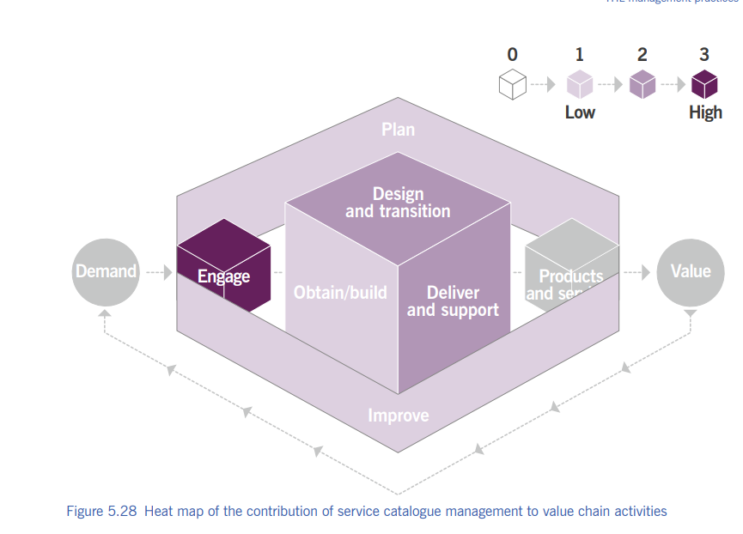

Slide 217
2.11 Service Configuration Management

Slide 218
4 Service Configuration Management
To provide a single source of consistent information on all services and service offerings, ensuring it is available to relevant stakeholders.

Slide 219
4 What is a Configuration Item (CI)?
Configuration Item (CI): Any component that needs to be managed to deliver a service.
Examples:
Servers,Applications,Databases,Network, devices,Documents

Slide 220
4 Configuration Management Database (CMDB)
A database that stores information about CIs and their relationships.

Slide 221
4 Key Activities
Identify and record CIs
Maintain CI information
Control changes to CIs
Verify and audit configurations
Manage relationships between CIs

Slide 222
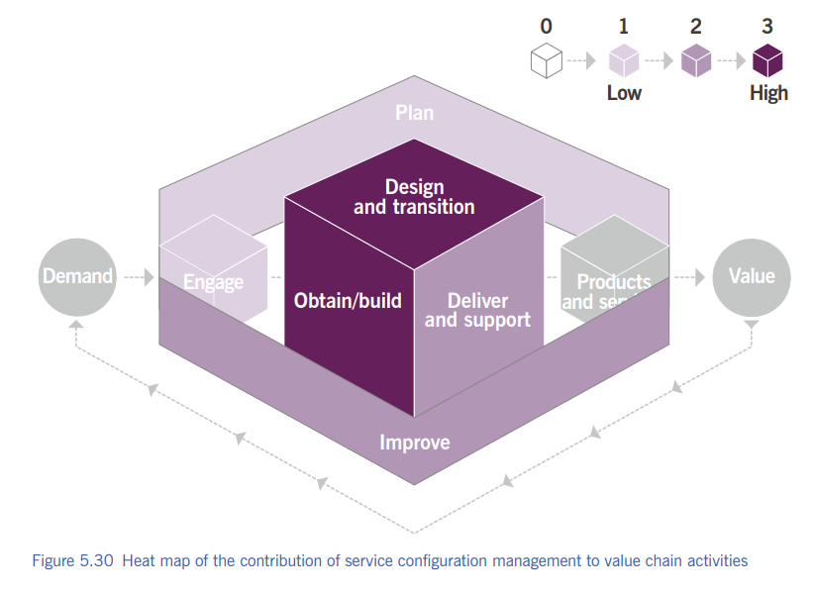

Slide 223
2.12 Service Continuity Management

Slide 224
4 Service Continuity Management
To ensure that services can continue or be recovered within agreed time frames after a disruptive event.

Slide 225
4 What is Service Continuity?
Ability of an organization to continue delivering services at acceptable levels after disruption.

Slide 226
4 Key Activities
Identify critical services
Perform risk assessment
Develop continuity plans
Test recovery plans
Review and improve plans

Slide 227
4 Relationship with Other Practices
Availability management – uptime
Incident management – short-term recovery
Problem management – root cause
Risk management – threats

Slide 228
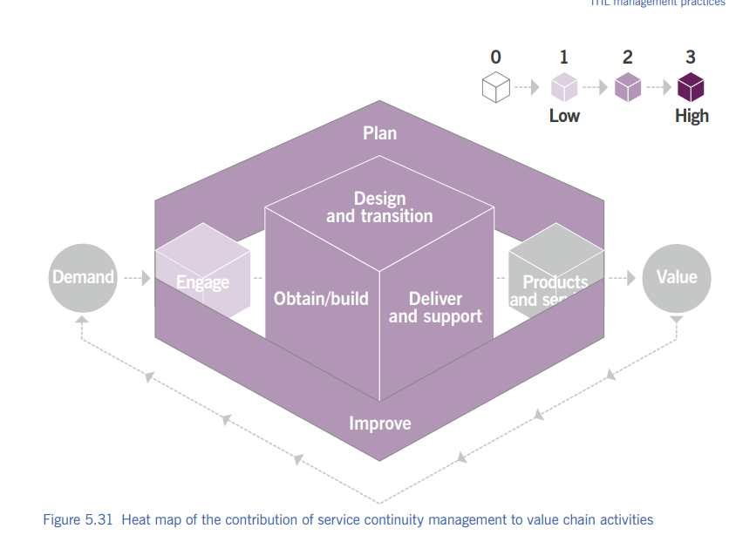

Slide 229
2.13 Service Design

Slide 230
4 Service Design
To design products and services that are fit for purpose, fit for use, and deliver value to customers.

Slide 231
4 What is Service Design?
Service Design focuses on:
Customer needs
Business requirements
Service quality
Cost and risk

Slide 232
4 Key Activities
Design new services
Design changes to services
Design service architectures
Design service metrics and SLAs
Design for availability, capacity, continuity, security

Slide 233
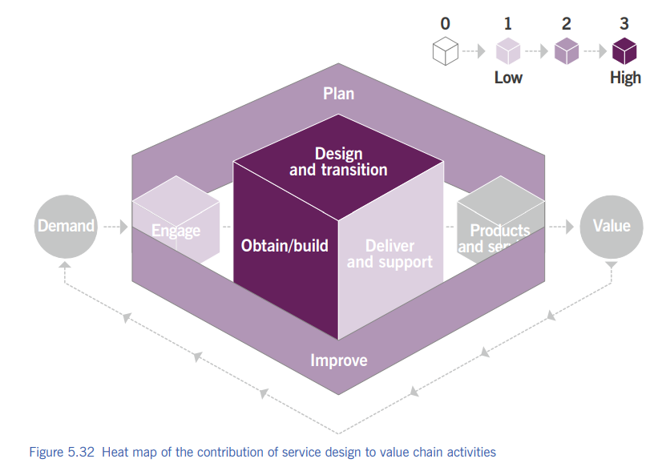

Slide 234
2.14 Service Desk

Slide 235
4 Service Desk
To capture demand for incident resolution and service requests, and to be the single point of contact between users and the service provider.

Slide 236
4 What is Service Desk?
A centralized function that handles:
Incidents
Service requests
User communication
Example: College IT helpdesk for ERP, email, Wi-Fi issues.

Slide 237
4 Types of Service Desk
Centralized – One location
Decentralized – Multiple locations
Virtual – Remote / online
Follow-the-sun – 24×7 global support

Slide 238
4 Key Activities
Log incidents and requests
Provide first-level support
Communicate with users
Escalate issues when needed
Keep users informed

Slide 239
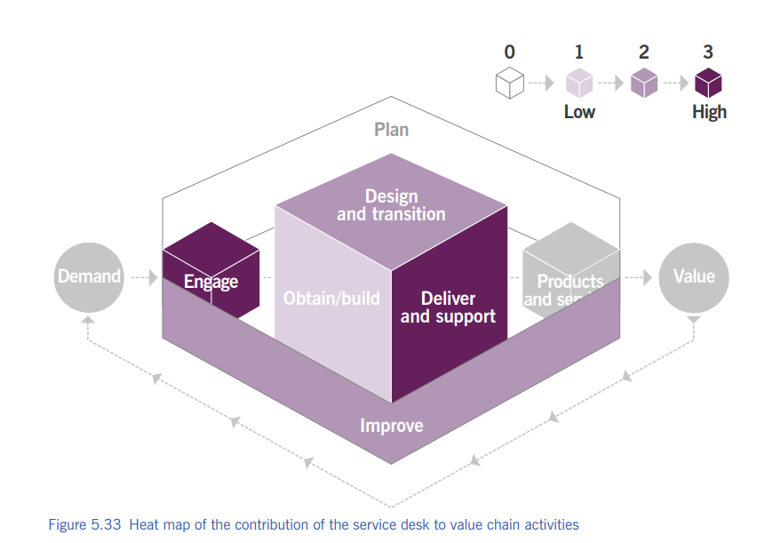

Slide 240
2.15 Service Level Management

Slide 241
4 Service Level Management
To set clear business-based targets for service performance so that delivery of a service can be properly assessed, monitored, and managed.

Slide 242
4 What is a Service Level?
A defined level of service quality agreed between the service provider and the customer.
Examples:
99.9% availability
Incident resolution within 4 hours
Helpdesk response in 15 minutes

Slide 243
4 SLA, OLA, Underpinning Contract
SLA (Service Level Agreement) – Provider ↔ Customer
OLA (Operational Level Agreement) – Internal teams
Underpinning Contract – External suppliers

Slide 244
4 Key Activities
Define service level targets
Agree and document SLAs
Monitor and report performance
Review and improve service levels
Manage customer expectations

Slide 245
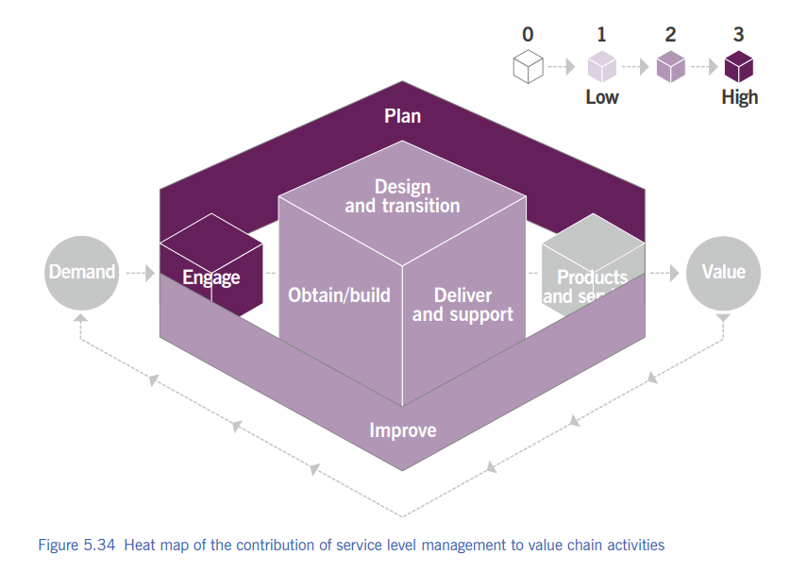

Slide 246
2.16 Service Request Management

Slide 247
4 Service Request Management
To support the agreed quality of a service by handling all pre-defined, user-initiated service requests in an effective and user-friendly manner.

Slide 248
4 What is a Service Request?
A formal request from a user for something standard and pre-approved.
Examples:
Password reset
New software installation
Access request
New email ID

Slide 249
4 Service Request vs Incident
Service Request → Something the user wants
Incident → Something is broken
Request = planned, Incident = unplanned

Slide 250
4 Key Activities
Receive and log requests
Approve requests (if needed)
Fulfil requests
Communicate status to users
Close requests

Slide 251
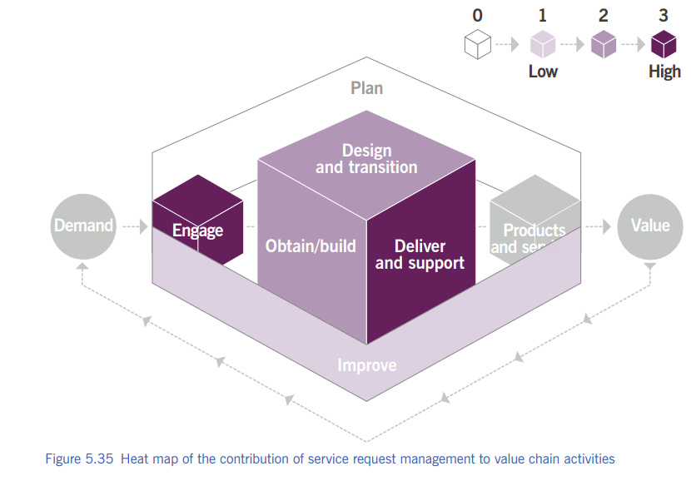

Slide 252
2.17 Service Validation and Testing

Slide 253
4 Service Validation and Testing
To ensure that new or changed services meet the defined requirements and deliver expected value before they are released.

Slide 254
4 What is Validated?
Functional requirements
Performance
Security
Usability

Slide 255
4 Validation vs Testing
Testing → Checking technical correctness
Validation → Checking user/business requirements
Testing = works correctly Validation = works as expected

Slide 256
4 When is it Performed?
Before release
During development
Before deployment
After major changes

Slide 257
4 Typical test types
Unit test
System test
Integration test
Regression test

Slide 258
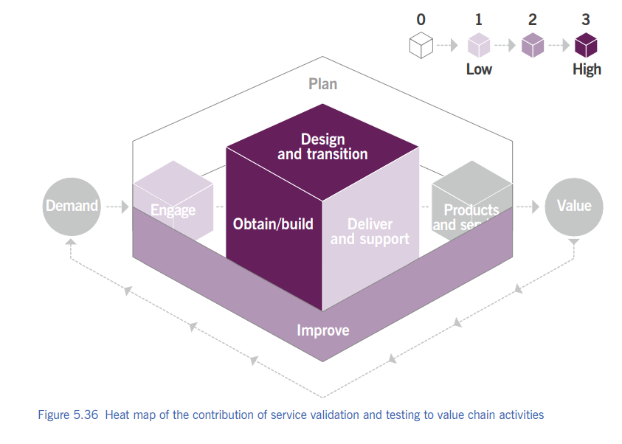

Slide 259
Technical Management

Slide 260
1. Deployment management 2. Infrastructure & platform management 3. Software development & management

Slide 261
3.1 Deployment Management

Slide 262
4 Deployment Management
To move new or changed components to live environments.
Components can be:
hardware
software
documentation
processes

Slide 263
4 Key points
Works with release management & change control
Ensures controlled deployment
Used for live, test, staging environments

Slide 264
4 Deployment approaches
Phased – gradual
Continuous delivery – frequent
Big bang – all at once
Pull – user chooses

Slide 265
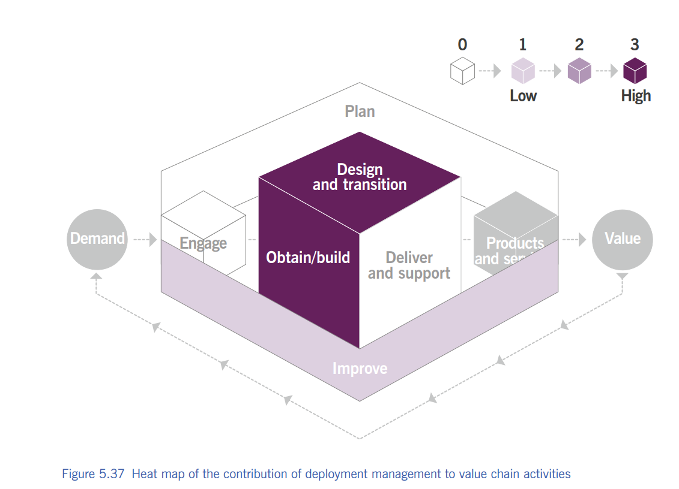

Slide 266
3.2 Infrastructure & Platform Management

Slide 267
4 Infrastructure & Platform Management
To oversee and manage infrastructure and platforms used to deliver IT services.
Servers, storage, networks, OS, middleware
Can be on-prem, cloud, or supplier-managed

Slide 268
4 Key points
Technology opportunities
Technology constraints
Readiness for new technologies (AI, cloud, automation)

Slide 269
4 Cloud Service Models
SaaS (Software as a Service) → User uses application; provider manages everything else
PaaS (Platform as a Service) → User deploys applications; provider manages infrastructure
IaaS (Infrastructure as a Service) → User gets servers, storage, network; provider manages physical infra

Slide 270
4 Cloud Deployment Models
Private cloud → Used by one organization only
Public cloud → Used by many organizations
Community cloud → Shared by organizations with common needs
Hybrid cloud → Combination of two or more clouds

Slide 271
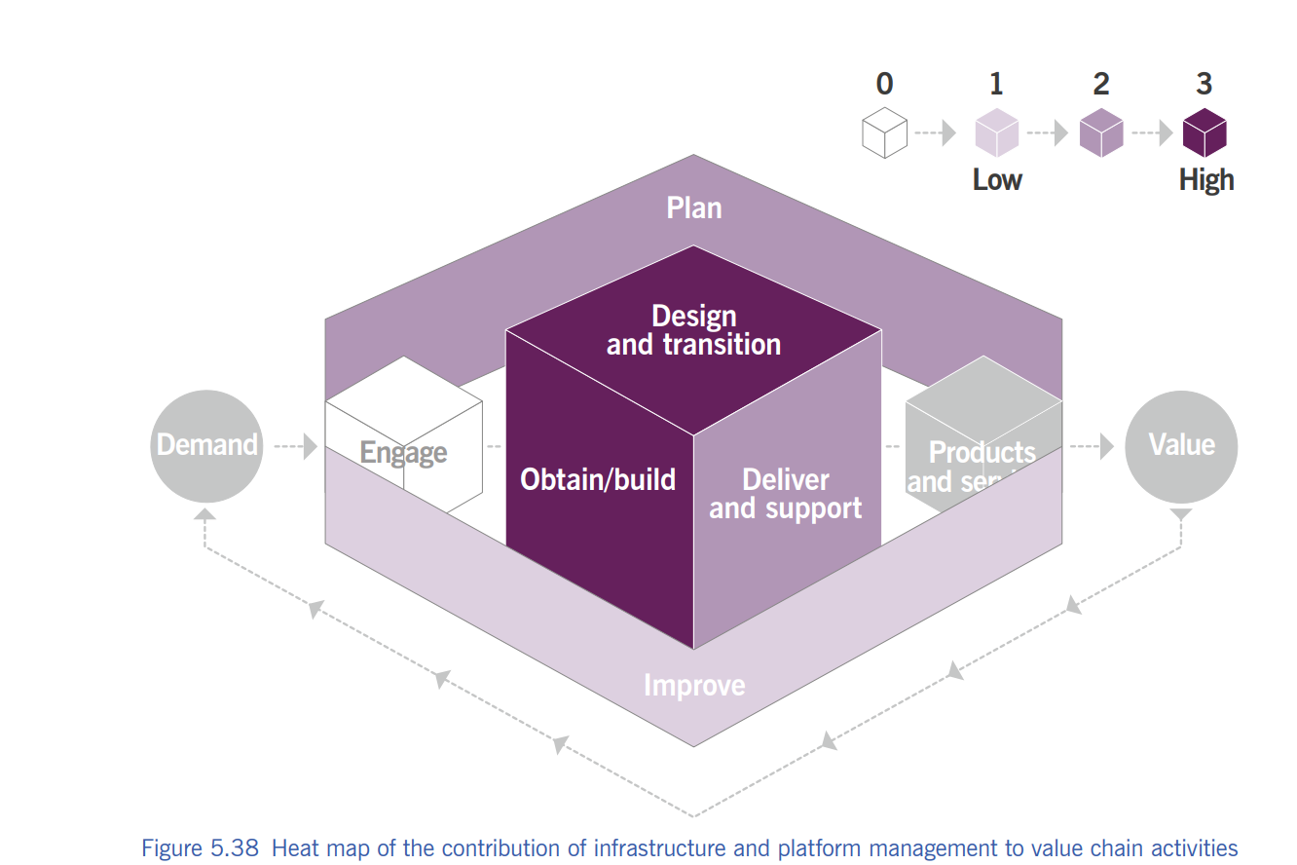

Slide 272
3.3 Software Development & Management

Slide 273
4 Software Development & Management
To ensure software meets stakeholder needs in functionality, reliability, and maintainability.

Slide 274
4 What does software include?
Apps
Websites
Mobile apps
OS & databases

Slide 275
4 Key activities
Solution design
Software development
Software testing
Version control
Code repositories
Waterfall
Agile

Slide 276
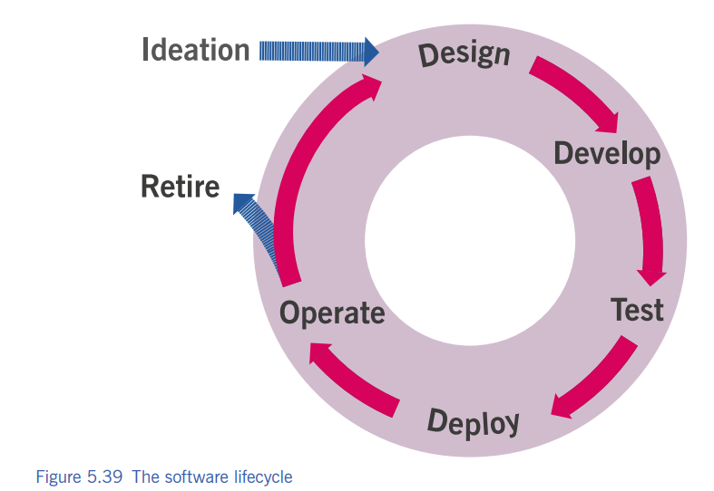

Slide 277
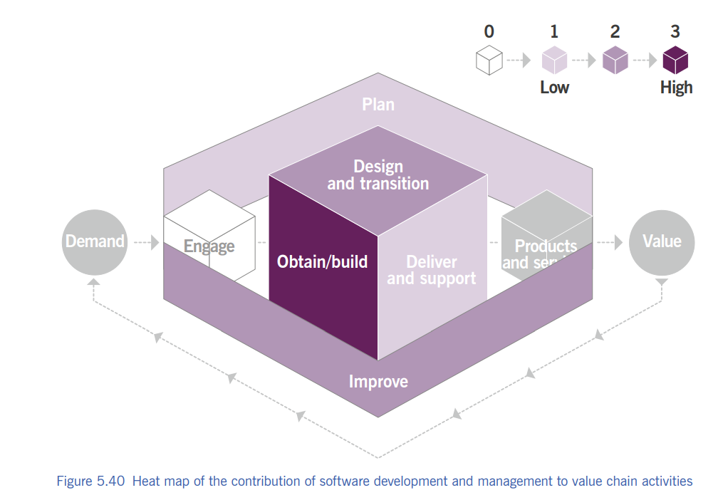

Slide 278

Thank you…

